Slide 1


TEXAS EOC
OVERVIEW
An overview of English I state testing for the Spring of 2017
ELA CONNECTIONS
By Cindy Blevins and Bailey Cundiff
for classroom use only
www.ELAConnections.com

Slide 2
English I EOC 2017 Overview
English I | # of Items | # of Raw Score Points Possible | Percentage of Test
Revision: 2-3 selections | 9 | 9 | 13%
Editing: 2-3 selections | 9 | 9 | 13%
Written Composition | 1 Composition (Expository) | 16 (summed score x 2) | 24%
Reading 2-3 single selections 2-3 paired selections (thematically linked) | 34 | 34 | 50%
TOTAL | 52 Multiple Choice 1 Composition | 68 Points | 100%
ELA CONNECTIONS
By Cindy Blevins and Bailey Cundiff
for classroom use only
www.ELAConnections.com
No Short Answers

Slide 3
English I EOC
TEST OVERVIEW
ASSESSMENT TIME LIMIT: To Be Determined
READING (50%)
→ Reading Multiple Choice (5-6 passages; 34 questions)
→ NO MORE SHORT ANSWER QUESTIONS
WRITING (50%)
→ 13% Revision Multiple Choice (2-3 passages; 9 questions)
→ 13% Editing Multiple Choice (2-3 passages; 9 questions)
→ 24% Essay (1 Expository Essay)
ELA CONNECTIONS
By Cindy Blevins and Bailey Cundiff
for classroom use only
www.ELAConnections.com

Slide 4
Reading
Single Selections (2-3)
Paired Selections (2-3, thematically linked)
Multiple Choice Questions (34)
NO SHORT ANSWER
May use dictionary
STAAR reading assessments will emphasize your ability to —
* make connections within and across
texts
* think critically/inferentially about
different types of texts
* understand how writer’s craft affects
meaning
* understand how to use text evidence to
confirm the validity of ideas.
TYPES OF PASSAGES
LITERARY
* Fiction
* Literary Nonfiction
* Poetry
* Drama
* Media Literacy (embedded)
INFORMATIONAL
* Expository
* Persuasive
* Procedural (embedded)
* Media Literacy (embedded)
ELA CONNECTIONS
By Cindy Blevins and Bailey Cundiff
for classroom use only
www.ELAConnections.com

Slide 5
Reading Multiple Choice Tips
BEFORE READING
Look over selection briefly to get an idea of what you’ll be reading. This increases reading comprehension.
DURING READING
Stay focused (take notes, underline, or highlight important words, people, places, and events). You will not do well if you do not read all of the selections.
Make connections, infer, think.
Read the visuals.
AFTER READING
Read questions carefully. Choose answers that
→ respond to the question
→ are accurate
→ are supported by the passage (look back to confirm answers)
Watch your Scantron (if paper testing)--don’t bend or erase, and no stray marks.
ELA CONNECTIONS
By Cindy Blevins and Bailey Cundiff
for classroom use only
www.ELAConnections.com

Slide 6
ESSAY INFO
EXPOSITORY ESSAY
Prompts contain
  a quote or statement
  a statement to help you think
  a writing task that starts with “Write . . .”
  a “Be sure to . . .”
Essays are 1 page (26 lines); 2 ½ pages to prewrite
Sample Prompt
ELA CONNECTIONS
By Cindy Blevins and Bailey Cundiff
for classroom use only
www.ELAConnections.com

Slide 7
ESSAY INFO
EXPOSITORY ESSAY
Graded on (1) ORGANIZATION/PROGRESSION
    Essays must EXPLAIN what YOU THINK about the topic.
    The organizing structure of the response must “fit” the purpose for expository writing (e.g., cause/effect, compare/contrast, problem/solution, etc.).
    The content of the response must be focused on the central “charge” of the prompt (the “Write about” not the “Read” or “Think about”). The more narrow the focus, the better; write “deep,” not “wide.”
    The essay must be focused on an explicit, specific controlling idea (thesis) which represents your “take” on the topic. It must be a direct statement of what will be explained and must give the reader a clear idea of the goal of the essay.
    All sentences should contribute to the meaning and enhance understanding. Use meaningful transitions to clarify relationships between sentences, paragraphs, and ideas. Everything must flow and connect.
ELA CONNECTIONS
By Cindy Blevins and Bailey Cundiff
for classroom use only
www.ELAConnections.com

Slide 8
ESSAY INFO
EXPOSITORY ESSAY
Graded on (2) DEVELOPMENT OF IDEAS
  The best development is real, based on your own experiences and thinking about the world using specific, well-chosen details.
  Each sentence must be connected to the previous sentence to build meaning. Each idea is enriched/enhanced by what comes before it.
  Meaningful transitions are a must; avoid mechanical transitions (first, next, then).
  Unconnected ideas = superficial development; superficial development = basic writing (not satisfactory or accomplished)
  The more original and individualistic the writing, the more engaging. Avoid formulaic writing and the inclusion of ideas that are too complicated, abstract, philosophical, or overly erudite for your writing skills. Write what you know!
ELA CONNECTIONS
By Cindy Blevins and Bailey Cundiff
for classroom use only
www.ELAConnections.com

Slide 9
ESSAY INFO
EXPOSITORY ESSAY
Graded on (3) USE OF LANGUAGE AND CONVENTIONS
  Words must fit the purpose and establish an appropriate tone.
  Effective word choice makes the writing more clear, more precise, and more interesting. Avoid using words incorrectly to impress.
  Expository essays can be written in 1st, 3rd, or even 2nd person. Use consistent point of view to enhance the develop your explanation.
  Sentences should be logical, meaningful, and controlled, making the flow of details or ideas easy to follow and understand.
  The strength of conventions is a holistic judgment, not one based on “counting” the number of errors. This is because some errors are more serious than others, and some result from an attempt to do something linguistically sophisticated.
  Control at the word and sentence level is necessary for effectiveness at the paragraph and essay level.
ELA CONNECTIONS
By Cindy Blevins and Bailey Cundiff
for classroom use only
www.ELAConnections.com

Slide 10
ESSAY TIPS
EXPOSITORY ESSAY (explain something)
Use the READ and THINK to give you writing ideas.
Draw a BOX around the WRITE part of the prompt. Make sure you write about this. Use a dictionary, if needed, to understand the prompt.
Use the blank pages to explore your topic/prewrite.
Make sure you don’t writ a story. You are explaining something.
EXPLAIN what you know about the topic from personal experiences, books you’ve read, movies you’ve seen; local events, etc.
Make sure you have a strong thesis supported by relevant examples.
Introduction and conclusion should be short, but effective.
Write “tight.” Make every work count (use a dictionary).
Thesis
Help
ELA CONNECTIONS
By Cindy Blevins and Bailey Cundiff
for classroom use only
www.ELAConnections.com
Sample 4 Essay

Slide 11
ESSAY TIPS
Brainstorm numerous ways to address the prompt (choose the one that is most unique and that you can best support).
Organize your ideas (for higher scores).
Write (show don’t tell)—don’t worry about conventions.
Silently read over essay. Make changes to make it clear and easy to understand and to assure strong words.
Read over it again for conventions (correctness).
-- slow down = comma
-- stop = period
-- bottom up editing
-- use dictionary for spelling
Rewrite it in your best handwriting (you
can omit this with careful prewriting; it’s
OK to have neat revisions/corrections).
ELA CONNECTIONS
By Cindy Blevins and Bailey Cundiff
for classroom use only
www.ELAConnections.com

Slide 12
REVISING
FOCUS ON EFFECTIVENESS--Strengthening and improving various aspects of a piece of writing:
    Thesis statement
    Introduction and conclusion
    Organization/progression
    Development
    Language/word choice
    Sentences
ELA CONNECTIONS
By Cindy Blevins and Bailey Cundiff
for classroom use only
www.ELAConnections.com

Slide 13
EDITING
FOCUS ON CORRECTNESS (CONVENTIONS):
    capitalization
    punctuation
    spelling
    grammar
    usage
    sentence boundaries (fragments and run-ons)
ELA CONNECTIONS
By Cindy Blevins and Bailey Cundiff
for classroom use only
www.ELAConnections.com

Slide 14
REVISING AND EDITING TIPS
    Read the questions first and mark key words/phrases.
    Identify focus sentences or paragraphs in the passage.
    Read the title and any introductory information.
    Read the entire passage and mark anything that is or seems incorrect, confusing, or unclear.
    Answer the questions while referring back to the passage, and mark your answers carefully.
    Use a dictionary, if needed.
ELA CONNECTIONS
By Cindy Blevins and Bailey Cundiff
for classroom use only
www.ELAConnections.com

Slide 15
FINAL TIPS
    Get a good night’s sleep the night before the test.
    Eat a good breakfast the morning of the test.
    Arrive at school on time or a little early.
    Bring water and a healthy, quiet, non-messy snack to refuel during the test, if permitted by your school.
    Bring pencils plus a book to read after the test.
ELA CONNECTIONS
By Cindy Blevins and Bailey Cundiff
for classroom use only
www.ELAConnections.com

Slide 16
Make the Connection!
You can do it!
ELA CONNECTIONS
By Cindy Blevins and Bailey Cundiff
for classroom use only
www.ELAConnections.com

Slide 17
ELA CONNECTIONS
By Cindy Blevins and Bailey Cundiff
for classroom use only
www.ELAConnections.com

Slide 18
PowerPoint hyperlink slides to follow
ELA CONNECTIONS
By Cindy Blevins and Bailey Cundiff
for classroom use only
www.ELAConnections.com

Slide 19
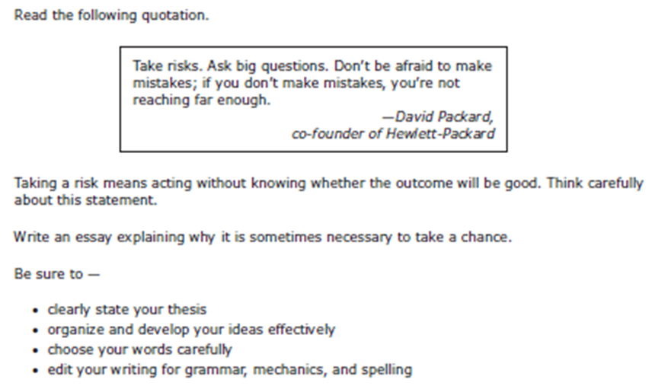
SAMPLE PROMPT
ELA CONNECTIONS
By Cindy Blevins and Bailey Cundiff
for classroom use only
www.ELAConnections.com
← BACK

Slide 20
THESIS STATEMENT
The THESIS STATEMENT is the power of the essay.
    PROMPT: Write an essay explaining why it is sometimes necessary to take a chance.
    SAMPLE THESIS STATEMENTS:
    1. It is sometimes necessary to take a chance (prompt wording) in
    order to grow as a student (specific, central idea).
    This first thesis statement is narrow and increases your chances for a higher score. You would simply explain how taking a chance to grow as a student (taking risks in writing to achieve a higher essay score at the risk of making a zero and trying out for something you really want to do, like playing basketball, even though you are nervous and afraid you won’t make the team) helps you grow as a student.
    REMEMBER, you only have 26 lines. Think narrow and deep, not wide.
ELA CONNECTIONS
By Cindy Blevins and Bailey Cundiff
for classroom use only
www.ELAConnections.com
NEXT →

Slide 21
THESIS STATEMENT
The THESIS STATEMENT is the power of the essay.
    PROMPT: Write an essay explaining why it is sometimes necessary to take a chance.
    SAMPLE THESIS STATEMENTS:
    2. It is sometimes necessary to take a chance (prompt
    wording) in order to grow as a student (specific, central
    idea) and gain the respect of adults.
    In this second thesis statement, you would give one example to explain each idea. The only problem with this is that both ideas must connect to the prompt AND to the other idea. If not, your score will be lower.
    REMEMBER, you only have 26 lines. Think narrow and deep, not wide.
ELA CONNECTIONS
By Cindy Blevins and Bailey Cundiff
for classroom use only
www.ELAConnections.com
NEXT →

Slide 22
THESIS STATEMENT
The THESIS STATEMENT is the power of the essay.
    PROMPT: Write an essay explaining why it is sometimes necessary to take a chance.
    SAMPLE THESIS STATEMENTS (con’t.):
    3. Taking chances allows us to look deeper inside ourselves and
    change our lives for the better.
    ~ addresses prompt, but doesn’t use specific prompt
    wording
    ~ uses “taking chances” instead of “taking risks”
    ~ insightful, philosophical thesis which makes for a more
    insightful and philosophical essay
    ~ notice pronouns “us” and “our”
    REMEMBER, you only have 26 lines.
    Think narrow and deep, not wide.
ELA CONNECTIONS
By Cindy Blevins and Bailey Cundiff
for classroom use only
www.ELAConnections.com
← BACK

Slide 23
THESIS STATEMENT
The THESIS STATEMENT is the power of the essay.
    PROMPT: Write an essay explaining why it is sometimes necessary to take a chance.
    SAMPLE THESIS STATEMENTS (con’t.):
    4. It is necessary to first take a chance before making a change.
    ~ uses some prompt language
    ~ very specific (helps keep essay specific and focused)
    It’s your turn! Write 1-2 thesis statements addressing this
    prompt. Be prepared to discuss.
ELA CONNECTIONS
By Cindy Blevins and Bailey Cundiff
for classroom use only
www.ELAConnections.com
← BACK

Slide 24
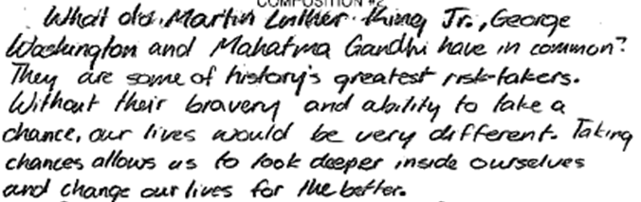
SAMPLE 4 ESSAY
INTRODUCTION
Thesis in last sentence.
ELA CONNECTIONS
By Cindy Blevins and Bailey Cundiff
for classroom use only
www.ELAConnections.com
NEXT →

Slide 25
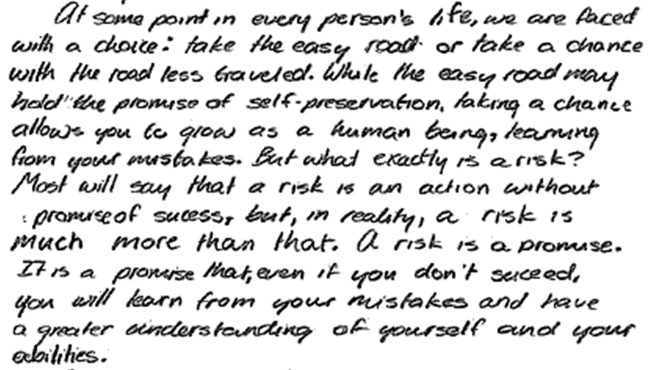
SAMPLE 4 ESSAY
BODY
Both paragraphs support thesis
insightful
The body explains the Thesis.
ELA CONNECTIONS
By Cindy Blevins and Bailey Cundiff
for classroom use only
www.ELAConnections.com
NEXT →

Slide 26
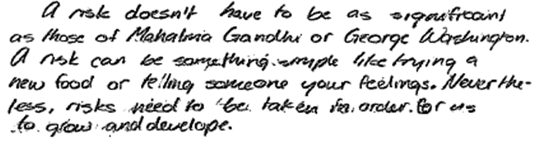
SAMPLE 4 ESSAY
CONCLUSION
The conclusion neatly connects introduction (first and last sentence) with body of paragraph (second sentence: examples of simple risks).
ELA CONNECTIONS
By Cindy Blevins and Bailey Cundiff
for classroom use only
www.ELAConnections.com
← BACK

