Slide 1
EXPOSITORY WRITING
IN COLOR

Slide 2
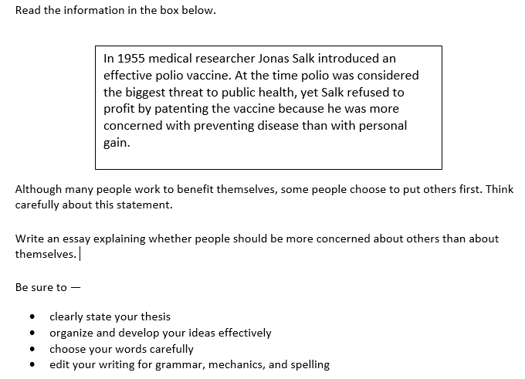
This is to help you think
You must write about this
BE SURE to address each of these

Slide 3
Muggings, shootings, and child custody battles are just a few events that regularly make the news. Then among the muck surfaces a ray of hope—a story about a middle school brother who elected to have surgery to save his brother’s life. What are the diferences in these stories? If you peel back all the layers of reason, you will find a basic element of concern: concern for self or concern for others. When people are more concerned about others than themselves, everyone wins.
Like the middle school brother, my grandmother was a person who was more concerned about others than about herself. She did not have much, but she gave what she had when someone needed it worse than she did. She always seemed to be clothing children and feeding families. She even opened her small home to my aunt and my four cousins when they were evicted by divorce and had no home of their own. Little did she know that someone noticed—someone who anonymously willed a beautiful home to her—someone who had also learned the joy of serving others.
Sadly, our prisons are filled with people who have not learned the joy of looking out for the needs of others—the intrinsic satisfaction of making someone’s life a little better or the extrinsic joy of receiving an unexpected gift like a home. These special joys are reserved only for the selfless. These people, and the people they help, are the real winners in life.
INTRODUCTION
BODY
CONCLUSION

Slide 4
Muggings, shootings, and child custody battles are just a few events that regularly make the news. Then among the muck surfaces a ray of hope—a story about a middle school brother who elected to have surgery to save his brother’s life. What are the diferences in these stories? If you peel back all the layers of reason, you will find a basic element of concern: concern for self or concern for others. When people are more concerned about others than themselves, everyone wins.
Like the middle school brother, my grandmother was a person who was more concerned about others than about herself. She did not have much, but she gave what she had when someone needed it worse than she did. She always seemed to be clothing children and feeding families. She even opened her small home to my aunt and my four cousins when they were evicted by divorce and had no home of their own. Little did she know that someone noticed—someone who anonymously willed a beautiful home to her—someone who had also learned the joy of serving others.
Sadly, our prisons are filled with people who have not learned the joy of looking out for the needs of others—the intrinsic satisfaction of making someone’s life a little better or the extrinsic joy of receiving an unexpected gift like a home. These special joys are reserved only for the selfless. These people, and the people they help, are the real winners in life.
INTRODUCTION –engages reader
THESIS is specific, clear
TRANSITION -linked to P1
BODY gives personal example
TRANSITION -linked to P1
CONCLUSION-linked to P1,2
THESIS connects to example
Colors show how Ideas are organized and developed effectively

Slide 5
Muggings, shootings, and child custody battles are just a few events that regularly make the news. Then among the muck surfaces a ray of hope—a story about a middle school brother who elected to have surgery to save his brother’s life. What are the diferences in these stories? If you peal back all the layers of reason, you will find a basic element of concern: concern for self or concern for others. When people are more concerned about others than themselves, everyone wins.
Like the middle school brother, my grandmother was a person who was more concerned about others than about herself. She did not have much, but she gave what she had when someone needed it worse than she did. She always seemed to be clothing children and feeding families. She even opened her small home to my aunt and my four cousins when they were evicted by divorce and had no home of their own. Little did she know that someone noticed—someone who anonymously willed a beautiful home to her—someone who had also learned the joy of serving others.
Sadly, our prisons are filled with people who have not learned the joy of looking out for the needs of others—the intrinsic satisfaction of making someone’s life a little better or the extrinsic joy of receiving an unexpected gift like a home. These special joys are reserved only for the selfless. These people, and the people they help, are the real winners in life.
OVER-THE-TOP: fluent use of conventions and word choice
Can you find the two spelling errors?

