Slide 1
PERSUASIVE WRITING
IN COLOR

Slide 2
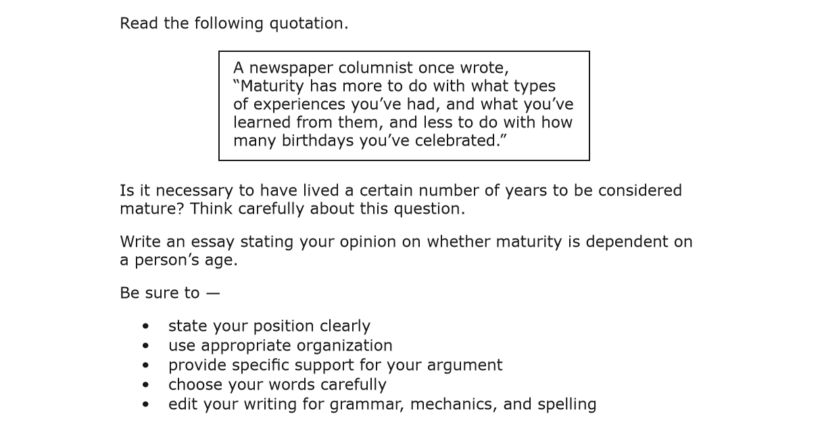
STUDENT PERSUASIVE ESSAY SAMPLE
STAAR English II, March 2016
This is to help you think
You must write about this
BE SURE to address each of these

Slide 3
STUDENT PERSUASIVE ESSAY SAMPLE
STAAR English II, March 2016
What do you notice?
Maturity is the development of the mind or body. Through out life people’s bodies often develop similarly and at a pace relative to their age. However, this is not always true about the mind. Maturity of the mind is gained through experience, not age. The experiences that often require people to mature the most are ones of adversity. As individuals face difficulties they must grow to overcome them. I, myself, have experienced this many times throughout my life and will continue to repeat this process till the day I die. However, one experience in particular required me to mature beyond any other: the tearing of my ACL. It was an athletes worst nightmare: surgery, 8 months recovery and hours of watching your teammates play the games you so desperately wanted to be apart of. What good could from this? I would ask myself daily. Not until later did I realize the answer was maturity. As I sat and watched those 8 months I acquired a new appreciation for the sport & I learned new aspects of the game I never would have noticed on the field. I gained respect for my teammates and better understood how I could help them and myself be successful. I came to realize how important it was to make every second count on the field and in life. This single experience matured me as a player and as a person beyond my years. Although many people believe maturity is dependent on age, it should be recognized that the development comes from experience. Maturity is part of growing up and becoming a successful adult perhaps this why many mistakingly associate it with age.

Slide 4
STUDENT PERSUASIVE ESSAY SAMPLE
STAAR English II, March 2016
Maturity is the development of the mind or body. Through out life people’s bodies often develop similarly and at a pace relative to their age. However, this is not always true about the mind. Maturity of the mind is gained through experience, not age. The experiences that often require people to mature the most are ones of adversity. As individuals face difficulties they must grow to overcome them. I, myself, have experienced this many times throughout my life and will continue to repeat this process till the day I die. However, one experience in particular required me to mature beyond any other: the tearing of my ACL. It was an athletes worst nightmare: surgery, 8 months recovery and hours of watching your teammates play the games you so desperately wanted to be apart of. What good could from this? I would ask myself daily. Not until later did I realize the answer was maturity. As I sat and watched those 8 months I acquired a new appreciation for the sport & I learned new aspects of the game I never would have noticed on the field. I gained respect for my teammates and better understood how I could help them and myself be successful. I came to realize how important it was to make every second count on the field and in life. This single experience matured me as a player and as a person beyond my years. Although many people believe maturity is dependent on age, it should be recognized that the development comes from experience. Maturity is part of growing up and becoming a successful adult perhaps this why many mistakingly associate it with age.
Position Statement
INTRODUCTION
Transitions

Slide 5
STUDENT PERSUASIVE ESSAY SAMPLE
STAAR English II, March 2016
Maturity is the development of the mind or body. Through out life people’s bodies often develop similarly and at a pace relative to their age. However, this is not always true about the mind. Maturity of the mind is gained through experience, not age. The experiences that often require people to mature the most are ones of adversity. As individuals face difficulties they must grow to overcome them. I, myself, have experienced this many times throughout my life and will continue to repeat this process till the day I die. However, one experience in particular required me to mature beyond any other: the tearing of my ACL. It was an athletes worst nightmare: surgery, 8 months recovery and hours of watching your teammates play the games you so desperately wanted to be apart of. What good could from this? I would ask myself daily. Not until later did I realize the answer was maturity. As I sat and watched those 8 months I acquired a new appreciation for the sport & I learned new aspects of the game I never would have noticed on the field. I gained respect for my teammates and better understood how I could help them and myself be successful. I came to realize how important it was to make every second count on the field and in life. This single experience matured me as a player and as a person beyond my years. Although many people believe maturity is dependent on age, it should be recognized that the development comes from experience. Maturity is part of growing up and becoming a successful adult perhaps this why many mistakingly associate it with age.
Position Statement
INTRODUCTION
Transitions
Personal Example supports thesis
BODY
Personal Example connected to Position Statement

Slide 6
STUDENT PERSUASIVE ESSAY SAMPLE
STAAR English II, March 2016
Maturity is the development of the mind or body. Through out life people’s bodies often develop similarly and at a pace relative to their age. However, this is not always true about the mind. Maturity of the mind is gained through experience, not age. The experiences that often require people to mature the most are ones of adversity. As individuals face difficulties they must grow to overcome them. I, myself, have experienced this many times throughout my life and will continue to repeat this process till the day I die. However, one experience in particular required me to mature beyond any other: the tearing of my ACL. It was an athletes worst nightmare: surgery, 8 months recovery and hours of watching your teammates play the games you so desperately wanted to be apart of. What good could from this? I would ask myself daily. Not until later did I realize the answer was maturity. As I sat and watched those 8 months I acquired a new appreciation for the sport & I learned new aspects of the game I never would have noticed on the field. I gained respect for my teammates and better understood how I could help them and myself be successful. I came to realize how important it was to make every second count on the field and in life. This single experience matured me as a player and as a person beyond my years. Although many people believe maturity is dependent on age, it should be recognized that the development comes from experience. Maturity is part of growing up and becoming a successful adult perhaps this why many mistakingly associate it with age.
Position Statement
INTRODUCTION
Transitions
Personal Example supports thesis
BODY
Personal Example connected to Position Statement
CONCLUSION

Slide 7
STUDENT PERSUASIVE ESSAY SAMPLE
STAAR English II, March 2016
1. Is position clearly stated?
2. Is appropriate organization used?
3. Is specific support provided for argument?
4. Are words carefully chosen?
Maturity is the development of the mind or body. Through out life people’s bodies often develop similarly and at a pace relative to their age. However, this is not always true about the mind. Maturity of the mind is gained through experience, not age. The experiences that often require people to mature the most are ones of adversity. As individuals face difficulties they must grow to overcome them. I, myself, have experienced this many times throughout my life and will continue to repeat this process till the day I die. However, one experience in particular required me to mature beyond any other: the tearing of my ACL. It was an athletes worst nightmare: surgery, 8 months recovery and hours of watching your teammates play the games you so desperately wanted to be apart of. What good could from this? I would ask myself daily. Not until later did I realize the answer was maturity. As I sat and watched those 8 months I acquired a new appreciation for the sport & I learned new aspects of the game I never would have noticed on the field. I gained respect for my teammates and better understood how I could help them and myself be successful. I came to realize how important it was to make every second count on the field and in life. This single experience matured me as a player and as a person beyond my years. Although many people believe maturity is dependent on age, it should be recognized that the development comes from experience. Maturity is part of growing up and becoming a successful adult perhaps this why many mistakingly associate it with age.
INTRODUCTION
Position Statement
Thesis
5. Are authentic transitions used to help the writing flow?
Transitions
Personal Example supports thesis
BODY
Personal Example connected to Position Statement
CONCLUSION
Can you find the 12 errors?

Slide 8
STUDENT PERSUASIVE ESSAY SAMPLE
STAAR English II, March 2016
OVER-THE-TOP: fluent use of conventions and word choice
Maturity is the development of the mind or body. Through out life people’s bodies often develop similarly and at a pace relative to their age. However, this is not always true about the mind. Maturity of the mind is gained through experience, not age. The experiences that often require people to mature the most are ones of adversity. As individuals face difficulties they must grow to overcome them. I, myself, have experienced this many times throughout my life and will continue to repeat this process till the day I die. However, one experience in particular required me to mature beyond any other: the tearing of my ACL. It was an athletes worst nightmare: surgery, 8 months recovery and hours of watching your teammates play the games you so desperately wanted to be apart of. What good could from this? I would ask myself daily. Not until later did I realize the answer was maturity. As I sat and watched those 8 months I acquired a new appreciation for the sport & I learned new aspects of the game I never would have noticed on the field. I gained respect for my teammates and better understood how I could help them and myself be successful. I came to realize how important it was to make every second count on the field and in life. This single experience matured me as a player and as a person beyond my years. Although many people believe maturity is dependent on age, it should be recognized that the development comes from experience. Maturity is part of growing up and becoming a successful adult perhaps this why many mistakingly associate it with age.

Slide 9
STUDENT PERSUASIVE ESSAY SAMPLE
STAAR English II, March 2016
How many errors can you find?
Maturity is the development of the mind or body. Through out life people’s bodies often develop similarly and at a pace relative to their age. However, this is not always true about the mind. Maturity of the mind is gained through experience, not age. The experiences that often require people to mature the most are ones of adversity. As individuals face difficulties they must grow to overcome them. I, myself, have experienced this many times throughout my life and will continue to repeat this process till the day I die. However, one experience in particular required me to mature beyond any other: the tearing of my ACL. It was an athletes worst nightmare: surgery, 8 months recovery and hours of watching your teammates play the games you so desperately wanted to be apart of. What good could from this? I would ask myself daily. Not until later did I realize the answer was maturity. As I sat and watched those 8 months I acquired a new appreciation for the sport & I learned new aspects of the game I never would have noticed on the field. I gained respect for my teammates and better understood how I could help them and myself be successful. I came to realize how important it was to make every second count on the field and in life. This single experience matured me as a player and as a person beyond my years. Although many people believe maturity is dependent on age, it should be recognized that the development comes from experience. Maturity is part of growing up and becoming a successful adult perhaps this why many mistakingly associate it with age.

Slide 10
STUDENT PERSUASIVE ESSAY SAMPLE
STAAR English II, March 2016
12 ERRORS in RED
Maturity is the development of the mind or body. Through out life,people’s bodies often develop similarly and at a pace relative to their age. However, this is not always true about the mind. Maturity of the mind is gained through experience, not age. The experiences that often require people to mature the most are ones of adversity. As individuals face difficulties,they must grow to overcome them. I, myself, have experienced this many times throughout my life and will continue to repeat this process till the day I die. However, one experience in particular required me to mature beyond any other: the tearing of my ACL. It was an athlete’s worst nightmare: surgery, 8 months,recovery and hours of watching your teammates play the games you so desperately wanted to be apart of. What good could from this? I would ask myself daily. Not until later did I realize the answer was maturity. As I sat and watched those 8 months I acquired a new appreciation for the sport & I learned new aspects of the game I never would have noticed on the field. I gained respect for my teammates and better understood how I could help them and myself be successful. I came to realize how important it was to make every second count on the field and in life. This single experience matured me as a player and as a person beyond my years. Although many people believe maturity is dependent on age, it should be recognized that the development comes from experience. Maturity is part of growing up and becoming a successful adult.perhaps this why many mistakingly associate it with age.

